Slide 1


Semi-Supervised Learning and the EM Algorithm
17
PART IV · LEARNING WITHOUT FULL LABELS
CHAPTER 17 · WEEK 14
Machine Learning — From Hypotheses to Decisions
LECTURER
Dr. Mustafa Hameed
THE ISLAMIA UNIVERSITY OF BAHAWALPUR
Bahawalpur, Pakistan
Department of Information Technology · BSIT · Fall 2026
Notes:
Chapter 17: Semi-Supervised Learning and the EM Algorithm. Part 4 — Learning Without Full Labels. Week 14: Semi-supervised learning and EM; hidden Markov models. Handout pages 125–133.

Slide 2

Where this chapter sits
THE COURSE
PART I
PART II
PART III
PART IV
PART V
PART VI
1
2
3
4
5
6
7
8
9
10
11
12
13
14
15
16
17
18
19
20
21
22
Semi-Supervised Learning and the EM Algorithm
BUILDS ON
USED LATER IN
Ch 2 Mathematics for Machine Learning
Ch 18 Hidden Markov Models
Ch 10 Bayesian Learning and Naive Bayes
Ch 21 Responsible and Ethical Machine Learning
Ch 15 Clustering
Machine Learning · Chapter 17 · Semi-Supervised Learning and the EM Algorithm
Handout p. 125 2
Notes:
Place the chapter. Before you start: Chapter 2 (the Gaussian, maximum likelihood), Chapter 10 (posteriors and naive Bayes) and Chapter 15 (k-means). The algorithm of this chapter returns in Chapter 18.

Slide 3

What you will be able to do
LEARNING OUTCOMES
By the end of this chapter you will be able to:
1
Explain when unlabelled examples can improve a classifier, and the assumptions that make it possible.
2
Describe self-training, and state its main risk.
3
Formulate a Gaussian mixture model with hidden cluster labels.
4
Perform an iteration of the EM algorithm by hand: responsibilities in the E-step, weighted means in the M-step.
5
Apply EM to a mixture of labelled and unlabelled data, and relate k-means to EM.
Machine Learning · Chapter 17 · Semi-Supervised Learning and the EM Algorithm
Handout p. 125 3
Notes:
Read these out: they are the chapter's contract with the room. Each click adds one.

Slide 4

Vocabulary for this chapter
KEY TERMS
semi-supervised learning
smoothness, cluster and manifold assumptions
self-training (pseudo-labelling)
confirmation bias
latent (hidden) variable
mixture model
Gaussian mixture
mixing weight
responsibility
EM algorithm
E-step
M-step
local maximum
hard vs. soft assignment
label propagation
Each term is defined where it first matters — not here.
Machine Learning · Chapter 17 · Semi-Supervised Learning and the EM Algorithm
Handout p. 125 4
Notes:
Do not define these now; they arrive one at a time. This slide is for the students' notes. Terms: semi-supervised learning; smoothness, cluster and manifold assumptions; self-training (pseudo-labelling); confirmation bias; latent (hidden) variable; mixture model; Gaussian mixture; mixing weight; responsibility; EM algorithm; E-step; M-step; local maximum; hard vs. soft assignment; label propagation.

Slide 5

In this chapter
IN THIS CHAPTER
17.1
Few Labels, Many Examples
p. 125 ›
17.2
Self-Training
p. 126 ›
17.3
Mixture Models and Hidden Variables
p. 126 ›
17.4
The EM Algorithm
p. 127 ›
17.5
EM With Labelled and Unlabelled Data
p. 128 ›
Machine Learning · Chapter 17 · Semi-Supervised Learning and the EM Algorithm
Handout pp. 125–133 5
Notes:
The route through the chapter. Each row is a link: click it to jump to that section in the slide show.

Slide 6
Few Labels, Many Examples
SECTION 1 OF 5
17.1
17.1 Few Labels, Many Examples
17.2 Self-Training
17.3 Mixture Models and Hidden Variables
17.4 The EM Algorithm
17.5 EM With Labelled and Unlabelled Data
Machine Learning · Chapter 17
Handout §17.1 6
Notes:
Pause. Name the question this section answers.

Slide 7
Few Labels, Many Examples
IN BRIEF
How can examples with no labels possibly help? Only if the way the examples are spread out says something about where the classes lie. Three assumptions, all versions of the same idea, make that true:
• Smoothness: examples close together are likely to share a label.
• Cluster: examples form clusters, and a cluster tends to be one class — so the decision boundary should pass through low-density gaps, not through the middle of a cluster.
• Manifold: high-dimensional data lies near a lower-dimensional surface, and distances along that surface are what matter.
Machine Learning · Chapter 17 · Semi-Supervised Learning and the EM Algorithm
§17.1 · Handout p. 125 7
Notes:
Labels are expensive. A senior engineer must read a ticket to name its root cause; a reviewer must study a commit to say whether it introduced a defect; a project manager must reconstruct why a project slipped. Unlabelled examples are nearly free: every ticket in the tracker, every commit in the history, every project in the archive. Semi-supervised learning uses both — a small labelled set and a large unlabelled one — to learn a better classifier than the labelled set alone would give.

Slide 8
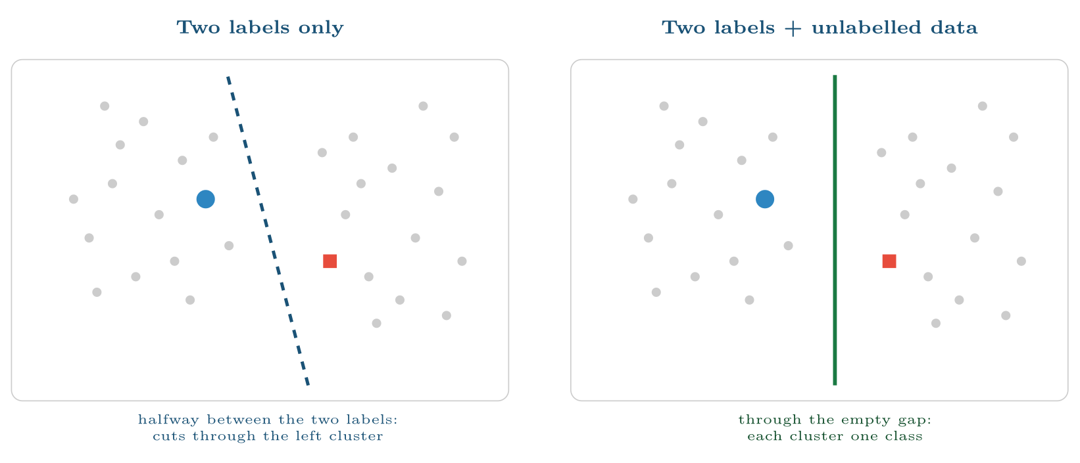
The cluster assumption
FIGURE 17.1
With two labelled points (blue circle, red square) a classifier puts the boundary between them, through the middle of a cluster. The unlabelled points (grey) reveal two clusters and a gap, and the boundary belongs in the gap.
Machine Learning · Chapter 17 · Semi-Supervised Learning and the EM Algorithm
§17.1 · Handout p. 125 8
Notes:
Figure 17.1 (handout p. 126): The cluster assumption. With two labelled points (blue circle, red square) a classifier puts the boundary between them, through the middle of a cluster. The unlabelled points (grey) reveal two clusters and a gap, and the boundary belongs in the gap.

Slide 9

Unlabelled Data Can Also Hurt
WATCH OUT
When the assumptions are false — the classes overlap in one blob, or a cluster contains both classes — unlabelled data pushes the boundary to the wrong place, and the semi-supervised model can be worse than one trained on the labels alone. Always compare against the labelled-only baseline on a held-out labelled test set.
Machine Learning · Chapter 17 · Semi-Supervised Learning and the EM Algorithm
§17.1 · Handout p. 125 9
Notes:
Read the box aloud, then ask for an example from the room before moving on.

Slide 10
Self-Training
IN BRIEF
The simplest method needs no new theory. Self-training (pseudo-labelling):
1. train a classifier on the labelled examples;
2. predict the unlabelled examples, and add those predicted with high confidence to the training set, with their predicted labels;
3. retrain, and repeat until no confident predictions remain.
Machine Learning · Chapter 17 · Semi-Supervised Learning and the EM Algorithm
§17.2 · Handout p. 126 10
Notes:
Read the box aloud, then ask for an example from the room before moving on.

Slide 11

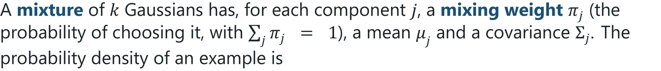

Gaussian Mixture Model
DEFINITION
If we knew which component produced each example, fitting would be easy: average each component’s own examples. If we knew the parameters, we could compute for each example the probability that each component produced it. We know neither — and the EM algorithm alternates between the two.
Machine Learning · Chapter 17 · Semi-Supervised Learning and the EM Algorithm
§17.3 · Handout p. 126 11
Notes:
It works with any classifier that gives probabilities, and on the tickets of this chapter’s lab it lifts accuracy from 92% with 50 labels to 97% using the 1,210 unlabelled tickets as well (all 1,260 labels give 98%). Its risk is confirmation bias: an early confident mistake becomes a training label, is reinforced at every round, and is never corrected. A high confidence threshold limits the damage. A more principled approach models how the data was generated. Suppose each example was produced by first picking a class (or cluster) z, then drawing x from that class’s distribution. For labelled examples z is observed; for unlabelled ones it is a hidden (latent) variable.

Slide 12
The EM Algorithm
SECTION 4 OF 5
17.4
17.1 Few Labels, Many Examples
17.2 Self-Training
17.3 Mixture Models and Hidden Variables
17.4 The EM Algorithm
17.5 EM With Labelled and Unlabelled Data
Machine Learning · Chapter 17
Handout §17.4 12
Notes:
Pause. Name the question this section answers.

Slide 13
Expectation–Maximisation (EM)
DEFINITION
Start from initial parameter guesses. Repeat until the likelihood stops improving:
• E-step: with the current parameters, compute for every example i and component j the responsibility r_{ij} below — the posterior probability that component j produced example i.
•
Each iteration never decreases the likelihood of the data, so EM converges — to a local maximum, which depends on the starting point.
Machine Learning · Chapter 17 · Semi-Supervised Learning and the EM Algorithm
§17.4 · Handout p. 127 13
Notes:
Read the box aloud, then ask for an example from the room before moving on.

Slide 14

EM for Two Means (Mitchell’s Example, in Numbers)
WORKED EXAMPLE
Six tickets took x = 1, 2, 3, 7, 8, 9 hours to resolve. There seem to be two kinds — quick fixes and investigations — but nobody recorded which was which. Model: two Gaussians with known σ = 1 and equal weights; unknown means. Start from μ₁ = 2, μ₂ = 5.
E-step. For each x, the densities are proportional to e^{−(x−μ)2/2}:
• x = 1: e^{−0.5} = 0.607 against e⁻⁸ = 0.0003 ⇒ r₁ = 0.999
• x = 2: e⁰ = 1 against e^{−4.5} = 0.011 ⇒ r₁ = 0.989
• x = 3: e^{−0.5} = 0.607 against e⁻² = 0.135 ⇒ r₁ = 0.818
• x = 7, 8, 9: component 2 is overwhelmingly likelier ⇒ r₁ ≈ 0
M-step. Responsibility-weighted means:
Machine Learning · Chapter 17 · Semi-Supervised Learning and the EM Algorithm
§17.4 · Handout p. 127 14
Notes:
Each click adds one step of the working. Ask for the next number before you reveal it.

Slide 15
EM for Two Means (Mitchell’s Example, in Numbers) (continued)
WORKED EXAMPLE
Note that x = 3 contributes 18% of itself to component 2: a soft assignment.
Iteration 2 moves the means to 2.000 and 8.000, after which nothing changes. The log-likelihood of the data rises from −24.96 at the starting means to −11.82 after one iteration and −11.67 at convergence. EM has found the two groups {1, 2, 3} and {7, 8, 9}.
Machine Learning · Chapter 17 · Semi-Supervised Learning and the EM Algorithm
§17.4 · Handout p. 127 15
Notes:
Each click adds one step of the working. Ask for the next number before you reveal it.

Slide 16
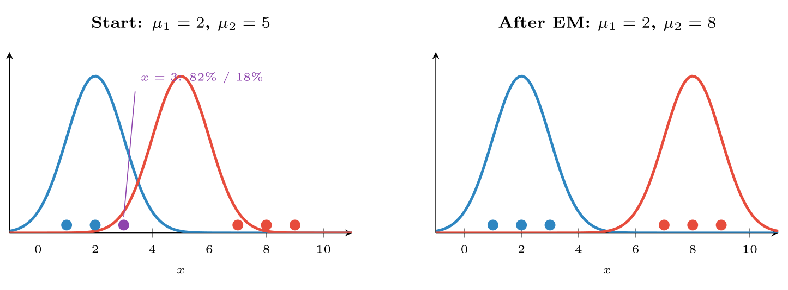
EM on the worked example
FIGURE 17.2
Each point is coloured by its responsibilities; x = 3 starts out shared between the components. Two iterations move the second Gaussian onto the group it explains.
Machine Learning · Chapter 17 · Semi-Supervised Learning and the EM Algorithm
§17.4 · Handout p. 127 16
Notes:
Figure 17.2 (handout p. 128): EM on the worked example. Each point is coloured by its responsibilities; x = 3 starts out shared between the components. Two iterations move the second Gaussian onto the group it explains.

Slide 17

k-Means Is EM With Hard Assignments
CONCEPT
Replace the E-step’s probabilities by a hard choice — responsibility 1 for the nearest mean, 0 for the others — and the M-step becomes “each mean is the average of its assigned points”. That is exactly k-means (Chapter 15). EM for Gaussian mixtures is the soft, probabilistic generalisation: clusters may overlap, may have different sizes and elongated shapes (through Σ_{j}), and each example gets a probability of membership instead of a verdict.
Machine Learning · Chapter 17 · Semi-Supervised Learning and the EM Algorithm
§17.4 · Handout p. 127 17
Notes:
Read the box aloud, then ask for an example from the room before moving on.

Slide 18
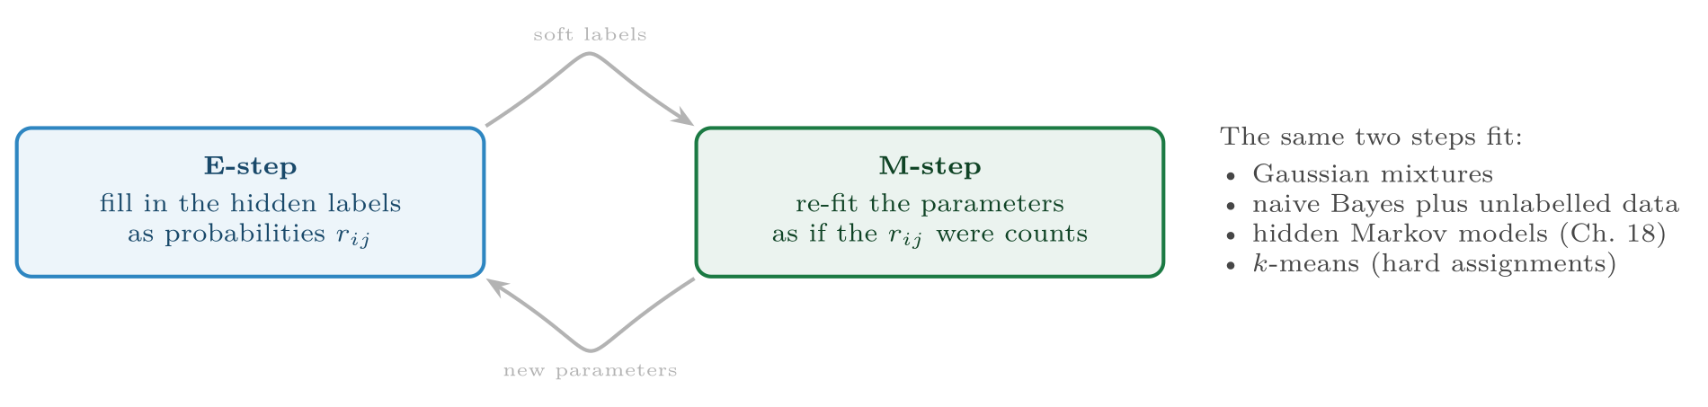
The EM Algorithm
FIGURE 17.3
The EM loop. Whenever a model would be easy to fit if some variable were observed, EM fills that variable in with probabilities and fits as if it were observed.
Machine Learning · Chapter 17 · Semi-Supervised Learning and the EM Algorithm
§17.4 · Handout p. 127 18
Notes:
Figure 17.3 (handout p. 128): The EM loop. Whenever a model would be easy to fit if some variable were observed, EM fills that variable in with probabilities and fits as if it were observed.

Slide 19
EM With Labelled and Unlabelled Data
SECTION 5 OF 5
17.5
17.1 Few Labels, Many Examples
17.2 Self-Training
17.3 Mixture Models and Hidden Variables
17.4 The EM Algorithm
17.5 EM With Labelled and Unlabelled Data
Machine Learning · Chapter 17
Handout §17.5 19
Notes:
Pause. Name the question this section answers.

Slide 20
EM With Labelled and Unlabelled Data
IN BRIEF
This is the method the HEC outline names. Nigam, McCallum, Thrun and Mitchell (2000) used it to classify text documents from a handful of labelled ones and thousands of unlabelled ones — exactly the position of a ticket tracker with two hundred triaged tickets and ten thousand untriaged. The recipe:
1. Fit the model — naive Bayes for text, or a Gaussian per class — on the labelled examples alone.
2. E-step: give each unlabelled example a probability for each class from the current model. Labelled examples keep their known labels (responsibility 1 for their class, 0 for the others).
3. M-step: refit the model on all examples, labelled ones counting in full and unlabelled ones fractionally, by their responsibilities.
4. Repeat until the parameters settle.
Machine Learning · Chapter 17 · Semi-Supervised Learning and the EM Algorithm
§17.5 · Handout p. 128 20
Notes:
Read the box aloud, then ask for an example from the room before moving on.

Slide 21
Two Labels and Four Unlabelled Points
WORKED EXAMPLE
The six tickets of the previous example, but now an engineer has checked two: the 3-hour ticket was a quick fix (class A) and the 7-hour ticket an investigation (class B); the rest are unlabelled.
Labelled data alone gives μ_{A} = 3, μ_{B} = 7, and a boundary at 5.
E-step. x = 1 and x = 2 are far likelier under A, and x = 8 and x = 9 under B; x = 3 and x = 7 are clamped to their labels.
M-step. μ_{A} = (1 + 2 + 3)/3 = 2 and μ_{B} = (7 + 8 + 9)/3 = 8, to within a thousandth. The next iteration changes nothing.
The class means moved from 3 and 7 to 2 and 8 using points nobody labelled. Here the boundary stays at 5, but it would not if the two groups had different spreads or sizes — and in higher dimensions the direction of the boundary moves too.
Machine Learning · Chapter 17 · Semi-Supervised Learning and the EM Algorithm
§17.5 · Handout p. 128 21
Notes:
The labelled examples anchor each component to a class — they say which cluster is which — and the unlabelled examples say where the clusters really are. The authors report that adding unlabelled documents to small labelled sets reduced text-classification error by up to 30%.
Each click adds one step of the working. Ask for the next number before you reveal it.

Slide 22

Common pitfalls
COMMON PITFALLS
✕
Skipping the labelled-only baseline. Unlabelled data can make a model worse; prove that it helped.
✕
Evaluating on pseudo-labels. Test only on examples with genuine labels, set aside before training.
✕
A low self-training threshold. Early mistakes become permanent labels.
✕
Running EM once. It finds a local maximum; start it several times and keep the highest likelihood.
✕
A mixture with the wrong shape. If the classes are not roughly Gaussian clusters, the mixture’s components will not line up with them.
Machine Learning · Chapter 17 · Semi-Supervised Learning and the EM Algorithm
§17.5 · Handout p. 128 22
Notes:
Graph-based methods such as label propagation take the smoothness assumption literally: connect each example to its nearest neighbours in a graph, fix the labelled nodes, and let labels diffuse along the edges until they settle. They follow curved clusters that a Gaussian mixture cannot represent.

Slide 23

Try it yourself: EM by Hand, Then Fifty Labels and a Thousand Guesses
TRY IT YOURSELF
Part 3 uses 1,800 synthetic tickets, each described by ten numeric features of its text and history, with four possible root causes; only 50 of the training tickets are labelled.
WHAT YOU WILL DO
1. EM for two Gaussian means (sigma = 1 known, equal weights)
2. Two labels, four unlabelled points
3. Self-training with 50 labels out of 1,260
THIS WEEK'S LAB
WHAT YOU WILL RUN
RUNNABLE COPY
Week 14: EM by hand; forward, Viterbi, Baum–Welch
1 listing, 49 lines of Python
code/ch17_em_hand_fifty_labels.py
Machine Learning · Chapter 17 · Semi-Supervised Learning and the EM Algorithm
§17.5 · Handout p. 128 23
Notes:
Part 3 uses 1,800 synthetic tickets, each described by ten numeric features of its text and history, with four possible root causes; only 50 of the training tickets are labelled.

Slide 24
EM by Hand, Then Fifty Labels and a Thousand Guesses
LAB · STEP 1 OF 4
Set-up
Python · code/ch17_em_hand_fifty_labels.py
2
3
4
5
6
7
8
import numpy as np
from sklearn.datasets import make_classification
from sklearn.model_selection import train_test_split
from sklearn.linear_model import LogisticRegression
from sklearn.semi_supervised import SelfTrainingClassifier
from sklearn.pipeline import make_pipeline
from sklearn.preprocessing import StandardScaler
Machine Learning · Chapter 17 · Semi-Supervised Learning and the EM Algorithm
§17.5 · Handout p. 128 24
Notes:
Step 1: Set-up. Read the code aloud; ask what each line would print before running it.

Slide 25
EM by Hand, Then Fifty Labels and a Thousand Guesses
LAB · STEP 2 OF 4
EM for two Gaussian means (sigma = 1 known, equal weights)
Python · code/ch17_em_hand_fifty_labels.py
10
11
12
13
14
15
16
17
18
# --- 1. EM for two Gaussian means (sigma = 1 known, equal weights) -------
x = np.array([1.0, 2.0, 3.0, 7.0, 8.0, 9.0])
mu = np.array([2.0, 5.0]) # initial guesses
for it in range(1, 5):
dens = np.exp(-0.5 * (x[:, None] - mu[None, :]) ** 2) # E-step
r = dens / dens.sum(axis=1, keepdims=True) # responsibilities
ll = np.log(dens.mean(axis=1) / np.sqrt(2 * np.pi)).sum()
mu = (r * x[:, None]).sum(axis=0) / r.sum(axis=0) # M-step
print(f"iteration {it}: log-likelihood {ll:8.3f} -> mu = {mu.round(3)}")
Machine Learning · Chapter 17 · Semi-Supervised Learning and the EM Algorithm
§17.5 · Handout p. 128 25
Notes:
Step 2: EM for two Gaussian means (sigma = 1 known, equal weights). Read the code aloud; ask what each line would print before running it.

Slide 26
EM by Hand, Then Fifty Labels and a Thousand Guesses
LAB · STEP 3 OF 4
Two labels, four unlabelled points
Python · code/ch17_em_hand_fifty_labels.py
20
21
22
23
24
25
26
27
28
29
30
# --- 2. two labels, four unlabelled points -------------------------------
labelled = {2: 0, 3: 1} # x=3 is class A (0), x=7 class B (1)
mu = np.array([x[2], x[3]]) # labelled points alone: 3 and 7
print("from the two labels alone: mu =", mu)
for it in range(10):
dens = np.exp(-0.5 * (x[:, None] - mu[None, :]) ** 2)
r = dens / dens.sum(axis=1, keepdims=True)
for i, c in labelled.items(): # a labelled point keeps its label
r[i] = np.eye(2)[c]
mu = (r * x[:, None]).sum(axis=0) / r.sum(axis=0)
print("EM with the unlabelled points too: mu =", mu.round(3))
Machine Learning · Chapter 17 · Semi-Supervised Learning and the EM Algorithm
§17.5 · Handout p. 128 26
Notes:
Step 3: Two labels, four unlabelled points. Read the code aloud; ask what each line would print before running it.

Slide 27
EM by Hand, Then Fifty Labels and a Thousand Guesses
LAB · STEP 4 OF 4
Self-training with 50 labels out of 1,260
Python · code/ch17_em_hand_fifty_labels.py
32
33
34
35
36
37
38
39
40
41
42
43
44
45
46
47
48
49
50
# --- 3. self-training with 50 labels out of 1,260 ------------------------
X, y = make_classification(n_samples=1800, n_features=10, n_informative=6,
n_redundant=2, n_classes=4, n_clusters_per_class=1,
class_sep=2.0, random_state=6) # 4 root causes
X_tr, X_te, y_tr, y_te = train_test_split(X, y, test_size=0.3,
random_state=0, stratify=y)
rng = np.random.default_rng(0)
keep = rng.choice(len(y_tr), size=50, replace=False)
y_part = np.full_like(y_tr, -1) # -1 means "unlabelled"
y_part[keep] = y_tr[keep]
base = make_pipeline(StandardScaler(), LogisticRegression())
only = base.fit(X_tr[keep], y_tr[keep]).score(X_te, y_te)
self_t = SelfTrainingClassifier(
make_pipeline(StandardScaler(), LogisticRegression()),
threshold=0.9).fit(X_tr, y_part)
print(f"50 labels only: {only:.3f} self-training with the rest "
f"unlabelled: {self_t.score(X_te, y_te):.3f} "
f"all {len(y_tr)} labels: "
f"{base.fit(X_tr, y_tr).score(X_te, y_te):.3f}")
Machine Learning · Chapter 17 · Semi-Supervised Learning and the EM Algorithm
§17.5 · Handout p. 128 27
Notes:
Step 4: Self-training with 50 labels out of 1,260. Read the code aloud; ask what each line would print before running it.

Slide 28
What the lab shows
TRY IT YOURSELF
Change the self-training threshold to 0.5 and then 0.99. Which is better, and what does the answer say about confirmation bias?
Machine Learning · Chapter 17 · Semi-Supervised Learning and the EM Algorithm
§17.5 · Handout p. 128 28
Notes:
Read the box aloud, then ask for an example from the room before moving on.

Slide 29

State the cluster assumption, and give an example where it fails.
CHECKPOINT 1 OF 3
Discuss with the person next to you, then advance.
Machine Learning · Chapter 17 · Semi-Supervised Learning and the EM Algorithm
Handout p. 133 · answers in Appendix D 29
Notes:
Ask the room. Do not advance until someone commits to an answer.

Slide 30

State the cluster assumption, and give an example where it fails.
CHECKPOINT 1 OF 3 · ANSWER
Examples in the same cluster tend to share a label, so the decision boundary should pass through low-density regions. It fails when classes overlap inside one cluster — for example tickets with different root causes whose text and history look the same (a timeout caused by the network and one caused by a slow database query).
Machine Learning · Chapter 17 · Semi-Supervised Learning and the EM Algorithm
Handout p. 133 · answers in Appendix D 30
Notes:
Answer (Appendix D): Examples in the same cluster tend to share a label, so the decision boundary should pass through low-density regions. It fails when classes overlap inside one cluster — for example tickets with different root causes whose text and history look the same (a timeout caused by the network and one caused by a slow database query).

Slide 31
In one EM iteration, what does the E-step compute and what does the M-step compute?
CHECKPOINT 2 OF 3
Discuss with the person next to you, then advance.
Machine Learning · Chapter 17 · Semi-Supervised Learning and the EM Algorithm
Handout p. 133 · answers in Appendix D 31
Notes:
Ask the room. Do not advance until someone commits to an answer.

Slide 32
In one EM iteration, what does the E-step compute and what does the M-step compute?
CHECKPOINT 2 OF 3 · ANSWER
The E-step computes, with the current parameters, each example’s responsibilities (the probability that each component produced it). The M-step re-estimates the parameters from the responsibility-weighted examples.
Machine Learning · Chapter 17 · Semi-Supervised Learning and the EM Algorithm
Handout p. 133 · answers in Appendix D 32
Notes:
Answer (Appendix D): The E-step computes, with the current parameters, each example’s responsibilities (the probability that each component produced it). The M-step re-estimates the parameters from the responsibility-weighted examples.

Slide 33
How does k-means differ from EM for a Gaussian mixture?
CHECKPOINT 3 OF 3
Discuss with the person next to you, then advance.
Machine Learning · Chapter 17 · Semi-Supervised Learning and the EM Algorithm
Handout p. 133 · answers in Appendix D 33
Notes:
Ask the room. Do not advance until someone commits to an answer.

Slide 34
How does k-means differ from EM for a Gaussian mixture?
CHECKPOINT 3 OF 3 · ANSWER
k-means makes hard assignments and estimates only means (implicitly round, equal clusters); EM for a Gaussian mixture makes soft assignments and also estimates covariances and mixing weights, maximising the likelihood.
Machine Learning · Chapter 17 · Semi-Supervised Learning and the EM Algorithm
Handout p. 133 · answers in Appendix D 34
Notes:
Answer (Appendix D): k-means makes hard assignments and estimates only means (implicitly round, equal clusters); EM for a Gaussian mixture makes soft assignments and also estimates covariances and mixing weights, maximising the likelihood.

Slide 35

What to take away
CHAPTER SUMMARY
1
Semi-supervised learning uses many unlabelled examples to improve a classifier trained on few labels, relying on the smoothness, cluster or manifold assumption; when those fail it can hurt.
2
Self-training adds confident predictions as labels and retrains; its risk is confirmation bias.
3
A Gaussian mixture explains data as coming from hidden components, each with a weight, mean and covariance.
4
EM alternates an E-step (responsibilities: soft assignments) and an M-step (responsibility-weighted re-estimates), never lowering the likelihood and converging to a local maximum; k-means is its hard-assignment special case.
5
With labelled and unlabelled data, labelled examples keep their labels in the E-step and anchor each component to a class.
Machine Learning · Chapter 17 · Semi-Supervised Learning and the EM Algorithm
Handout p. 133 35
Notes:
Ask the room to say each takeaway before you reveal it.

Slide 36

Quick check 1 of 3
REVIEW · MULTIPLE CHOICE
In the EM algorithm, the responsibilities are computed in:
A
the M-step
B
the E-step
C
the initialisation
D
neither step
Machine Learning · Chapter 17 · Semi-Supervised Learning and the EM Algorithm
Handout p. 133 36
Notes:
Take a show of hands for each option before discussing. (The handout does not print MCQ answers.)

Slide 37
Quick check 2 of 3
REVIEW · MULTIPLE CHOICE
k-means corresponds to EM with:
A
soft assignments
B
hard assignments
C
no M-step
D
labelled data only
Machine Learning · Chapter 17 · Semi-Supervised Learning and the EM Algorithm
Handout p. 133 37
Notes:
Take a show of hands for each option before discussing. (The handout does not print MCQ answers.)

Slide 38
Quick check 3 of 3
REVIEW · MULTIPLE CHOICE
Self-training’s main risk is:
A
underfitting
B
slow prediction
C
confirmation bias
D
the curse of dimensionality
Machine Learning · Chapter 17 · Semi-Supervised Learning and the EM Algorithm
Handout p. 133 38
Notes:
Take a show of hands for each option before discussing. (The handout does not print MCQ answers.)

Slide 39
For your notebook
REVIEW QUESTIONS
SHORT
Why can unlabelled data improve a classifier at all?
SHORT
Explain why EM can converge to different answers from different starting points, and what to do about it.
SHORT
In semi-supervised EM, what role do the labelled examples play that the unlabelled ones cannot?
APPLIED
Repeat the first EM iteration of the worked example with initial means μ₁ = 4, μ₂ = 6. Where do the means go?
APPLIED
For the values 0, 1, 5, 6 with σ = 1 and equal weights, start EM from μ₁ = 0, μ₂ = 1 and perform two iterations. Comment on the result.
Machine Learning · Chapter 17 · Semi-Supervised Learning and the EM Algorithm
Handout p. 133 39
Notes:
Set these for independent study. Model answers are not printed in the handout.

Slide 40
End of Chapter 17
17
NEXT
READ
Chapter 18 — Hidden Markov Models
Handout Chapter 17, pages 125–133
THIS WEEK'S LAB
ASSESSMENT
EM by hand; forward, Viterbi, Baum–Welch
Project experiments frozen
Machine Learning · Chapter 17 · Semi-Supervised Learning and the EM Algorithm
40
Notes:
Close. NEXT: Chapter 18 — Hidden Markov Models. READ: Handout Chapter 17, pages 125–133. THIS WEEK'S LAB: EM by hand; forward, Viterbi, Baum–Welch. ASSESSMENT: Project experiments frozen.

